Slide 1
Navigation and Localization of Unmanned Underwater Vehicles Using Fiducial Markers
Aryan Singh P.R.No.: 202111969
Chrisann Ferrao P.R.No.: 202111972
Govind Pandey P.R.No.: 202111798
Jayden Viegas P.R.No.: 202111978
Project Guide: Milind Fernandes

Slide 2
Abstract
Developed a low-cost vision-based AprilTag detection and localization system for Unmanned Underwater Vehicles (UUVs) using AprilTags utilizing PnP algorithm with dual USB cameras for pose calculation.
Transmission of pose data to Pixhawk 2.4.8 via MAVLink and visualization in QGroundControl.
Tested in controlled setups, demonstrating robustness, responsiveness, and suitability for confined underwater tasks.
Visualized camera trajectory using 3D plotting

Slide 3
Outline
Project Objectives
Results
Implementation
Conclusion & Future Scope
Challenges

Slide 4
Project Objectives
Fiducial Marker Detection: Implement a robust AprilTag-based system to extract precise position and orientation data.
Embedded Pipeline Deployment: Run the detection system on a Raspberry Pi with BlueOS for efficient real-time processing.
Dual USB Camera Setup with Calibration: Use two cameras and apply lens distortion correction to improve spatial accuracy.
Localization Data Transmission to Pixhawk: Establish reliable MAVLink-based UART communication to deliver real-world pose data.
Trajectory Visualization: Develop a Matplotlib-based tool to plot and analyze the UUV’s movement within the test area.

Slide 5
Implementation
Hardware and Software Components
Raspberry Pi 4 Model B
Pixhawk 2.4.8 Flight Controller
USB Camera
Fiducial Markers (AprilTags)
Python
BlueOS
QGroundControl

Slide 6
Why AprilTags?
High Contrast & Bold Geometry
Error-Tolerant Encoding
Advanced Detection Algorithms
Resilience to Blur & Distortion

Slide 7
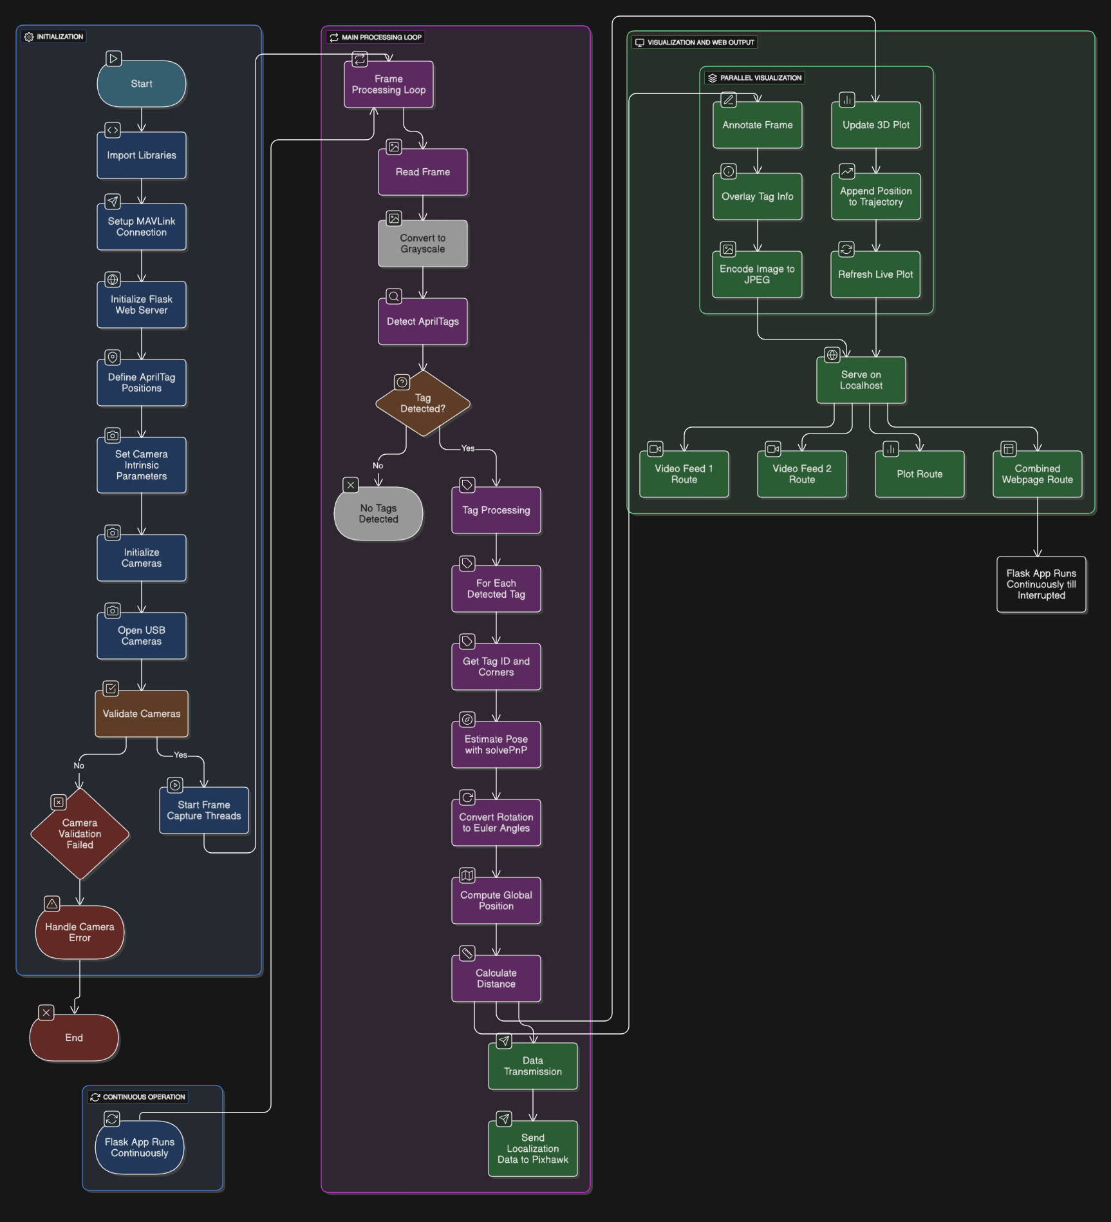
.
2.

Slide 8
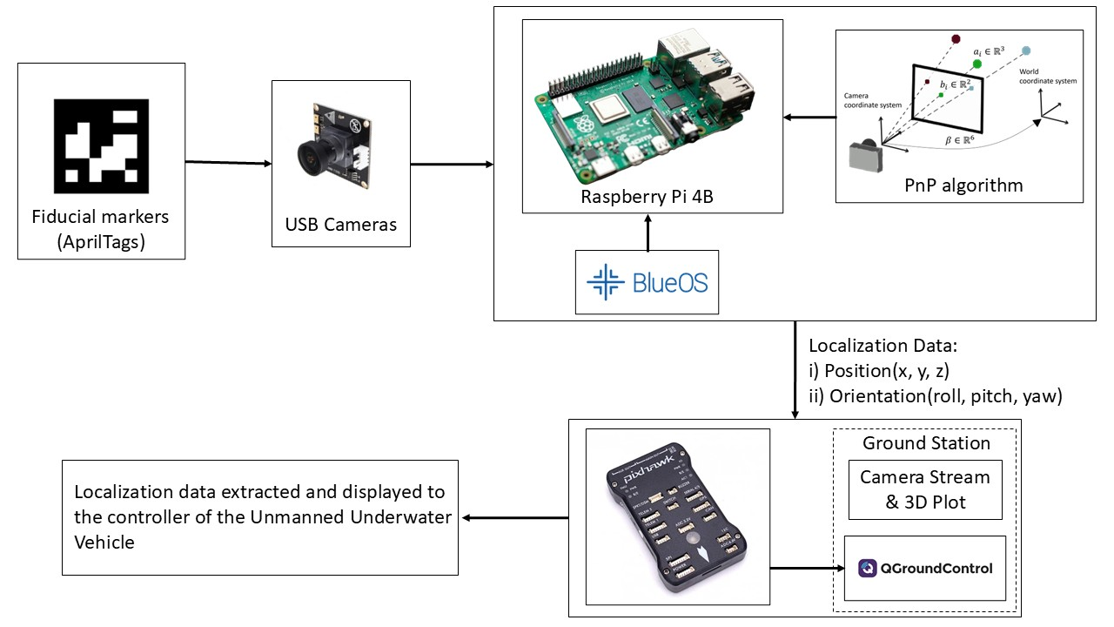
Block Diagram for Visual Localization and Control

Slide 9
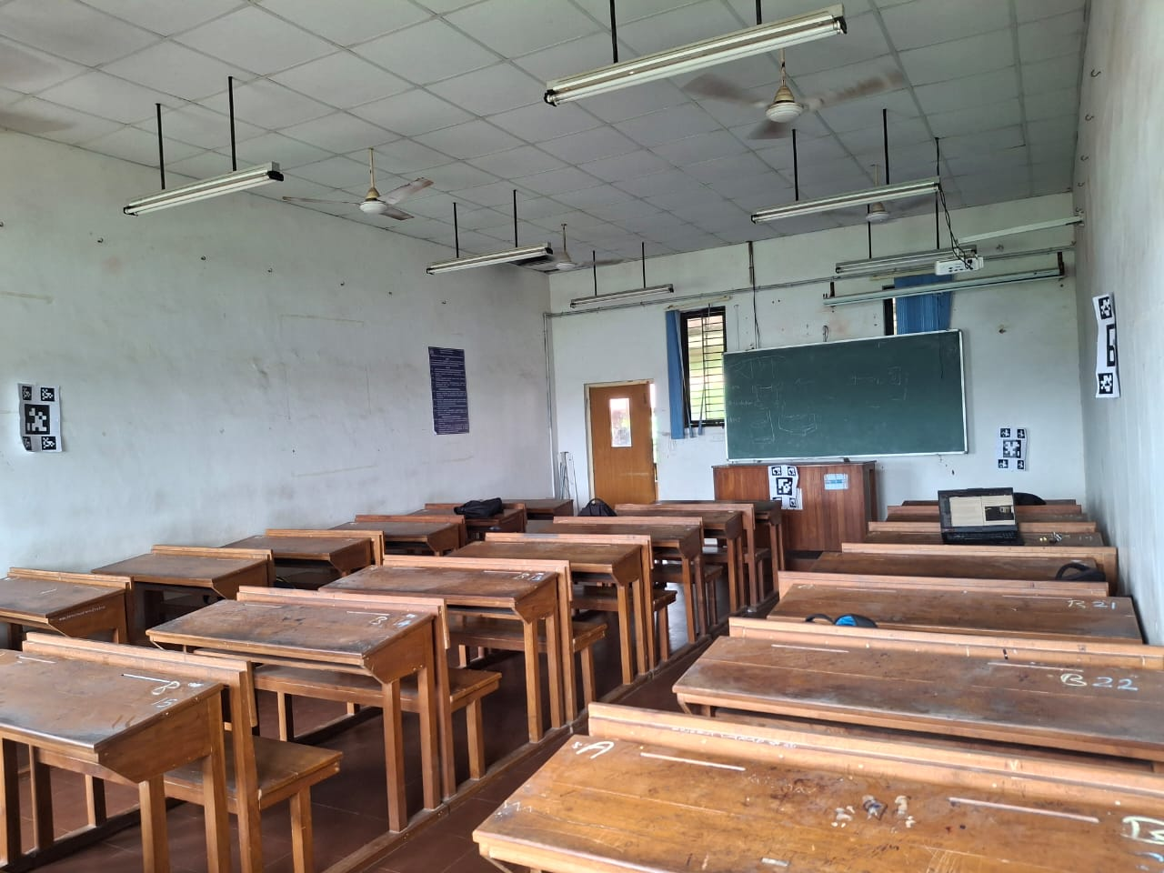
Test Area
Tags

Slide 10
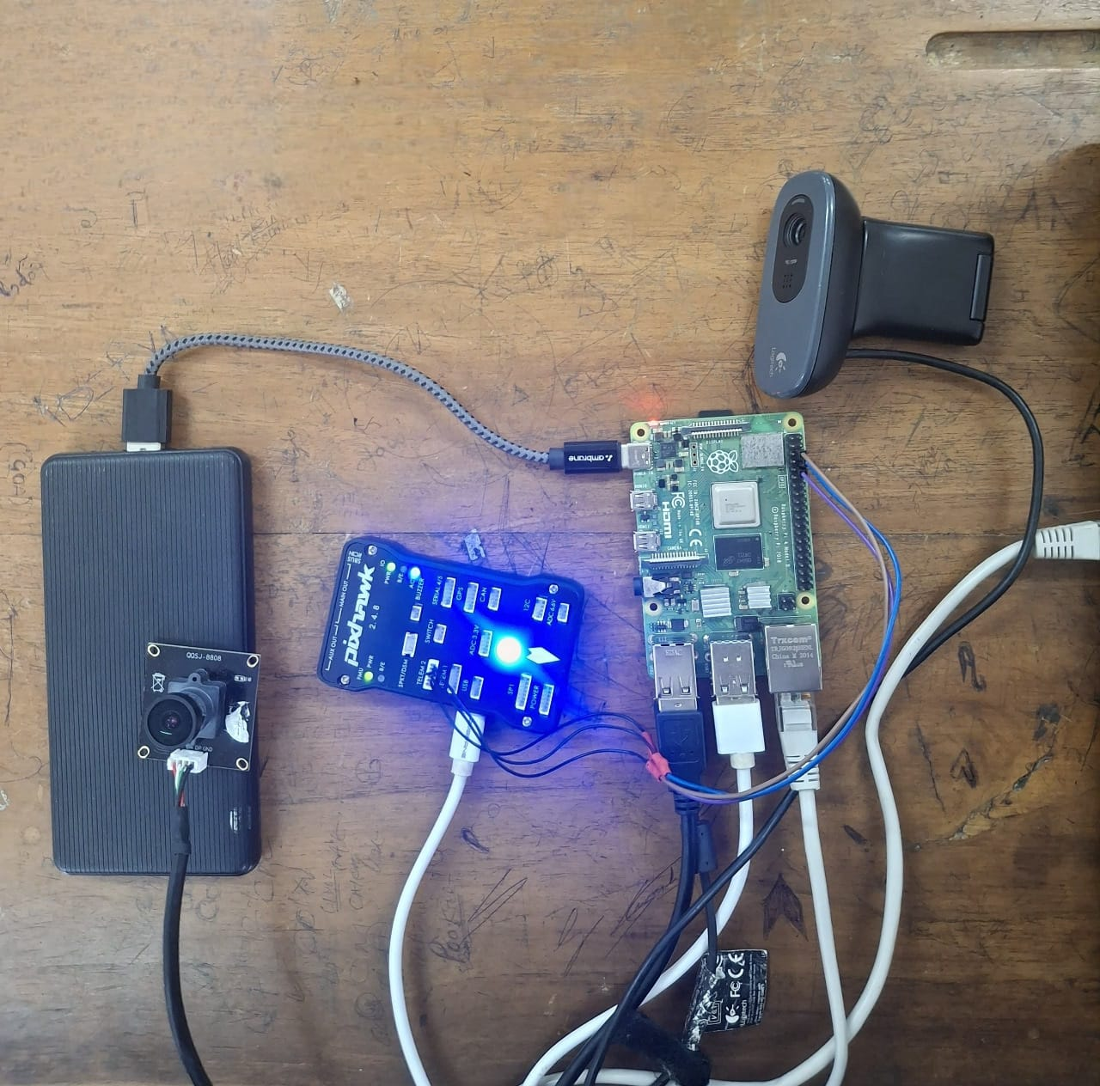
Hardware Setup
USB Camera 1
Pixhawk
Raspberry Pi 4B
USB Camera 2
Power Bank

Slide 11
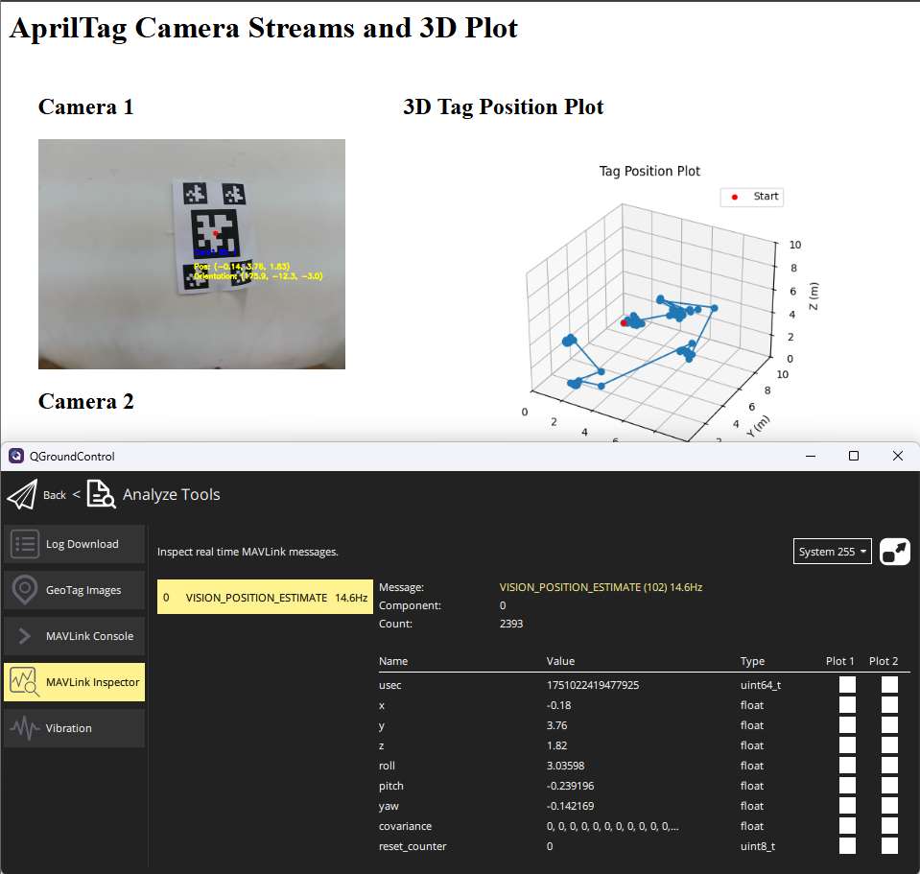
Ground Station
Camera Stream
Trajectory Plot

Slide 12
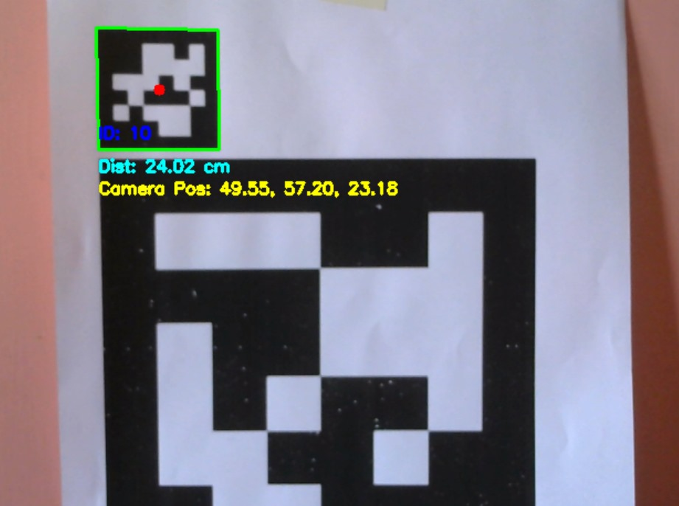
Results
AprilTag Detection and Vehicle Pose Estimation

Slide 13
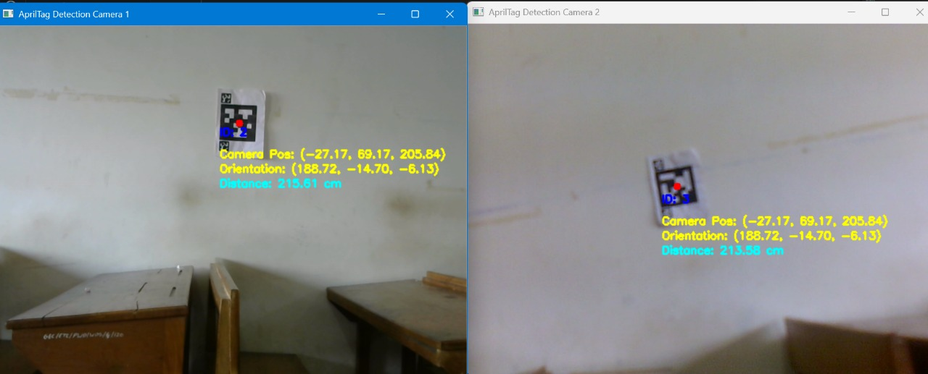
Dual Camera AprilTag Detection with 6 DOF Pose Estimation

Slide 14
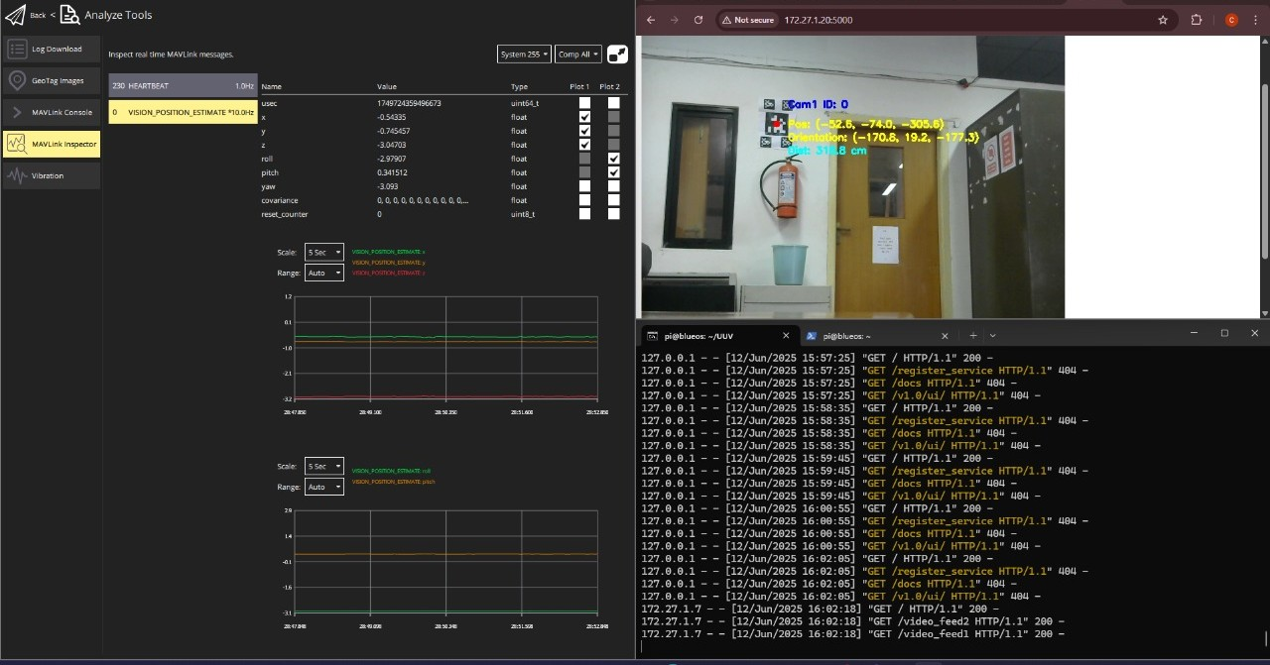
6 DOF Pose Displayed in QGC
Localization data received by pixhawk using mavlink

Slide 15
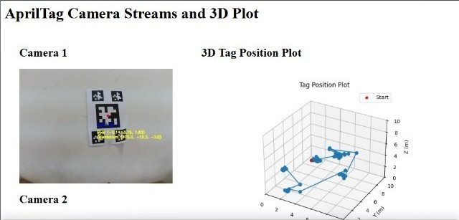
Camera Stream & Trajectory Plot

Slide 16
Challenges
Accurate Real-Time Localization
→ Use AprilTags with high-res cameras and real-time filtering (e.g., Kalman Filter)
Dynamic Tag Size Handling
→ Adaptive algorithm to prioritize tag size based on range and field of view
Camera Calibration Accuracy
→ Calibrate using checkerboard/fiducial grids in OpenCV; update periodically
Global Position Estimation
→ Use predefined AprilTag positions to transform relative pose to global coordinates
Global Coordinate Accuracy
→ Use OpenCV for pose estimation and validate outputs via visual testing
Dual Camera Interference
→ Apply multithreading, avoid overlapping views, and prioritize per-camera tag sets
BlueOS Performance Limits
→ Offload vision tasks to a parallel node; use BlueOS for telemetry; optimize system load

Slide 17
Conclusion
Effective Vision-Based Localization
Accurate use of AprilTags for 6DOF pose estimation in underwater-like, GPS-denied environments.
Accurate Pose Estimation
Reliable computation of position and orientation using solvePnP, with calibrated cameras and known tag positions.
System Integration
Seamless integration of Raspberry Pi 4, dual USB cameras, Pixhawk 2.4.8, and MAVLink communication for real-time localization.
Live Monitoring & Visualization
Flask-based interface enabled real-time video streaming and 3D trajectory visualization for performance analysis.

Slide 18
Future Work
Integration of Dual-Camera System
BlueOS Interface Enhancement
Waterproofing and Environmental Adaptations
Assembly and Preliminary Testing
Underwater Field Trials
System Optimization and Feedback Loop

Slide 19
Thank You

